Slide 1
MMA 867 Predictive Modelling Time Series Analysis
Queen's Master in Management Analytics Jue Wang

Slide 2
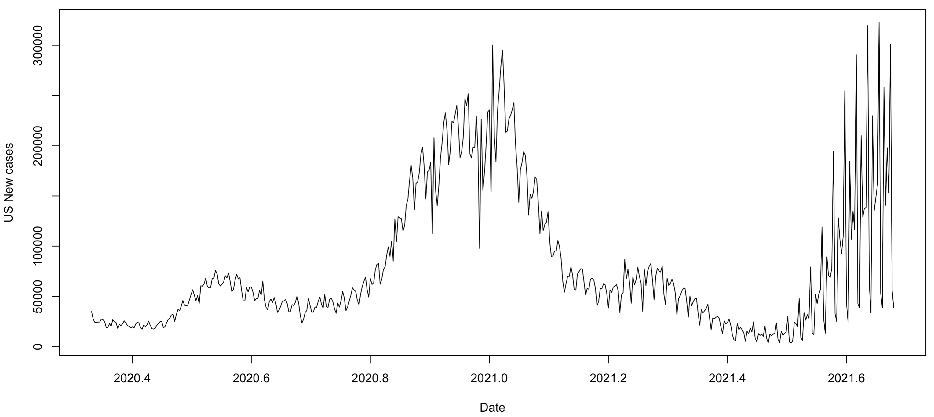
Time Series
A series of data points indexed in time order. e.g., Daily new cases of Covid-19 in the US
What do you observe from the plot?

Slide 3
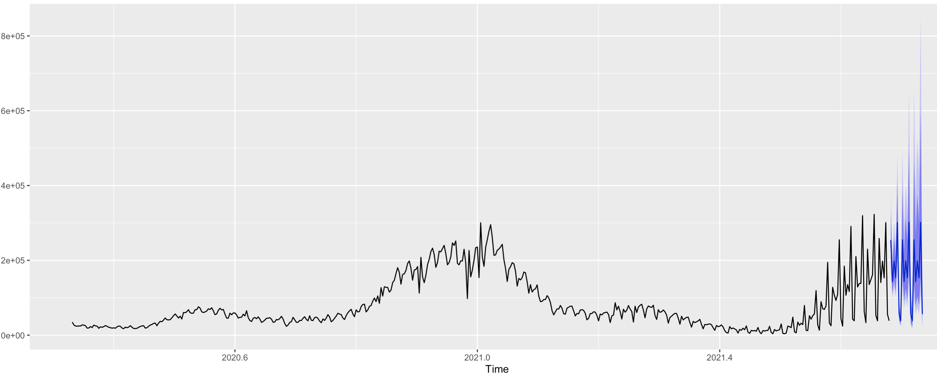
Time Series Forecasting
We will learn how to forecast the number of new cases in near future (e.g., next 20 days)

Slide 4
Learning Objectives
Conceptuel Understanding of Time Series Model (ARIMA)
Forecasting New cases of Covid-19 in the US
Group Discussion: Forecasting new death from Covid-19 in Canada over the next 14 days

Slide 5
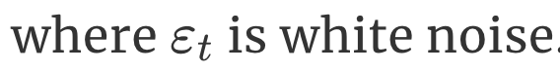
From Linear Regression to Time Series
We may create a linear regression model using the most recent p datapoints as predictors:
This is an autoregressive (AR) model with order p

Slide 6
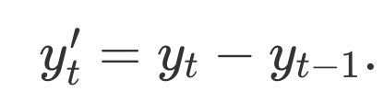
From Linear Regression to Time Series
If there is trend in the time series, we can often alleviate it through “regular differencing”
This is a regular differencing with order d=1

Slide 7
From Linear Regression to Time Series
The white noise terms are usually not flexible enough in practice. So we use a more generalized noise term
The extra noise terms are called moving average (MA) terms with order q.

Slide 8
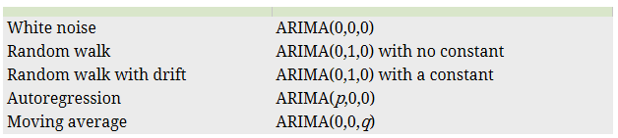
From Linear Regression to Time Series
We now have an ARIMA(p, d, q) model with d=1

Slide 9
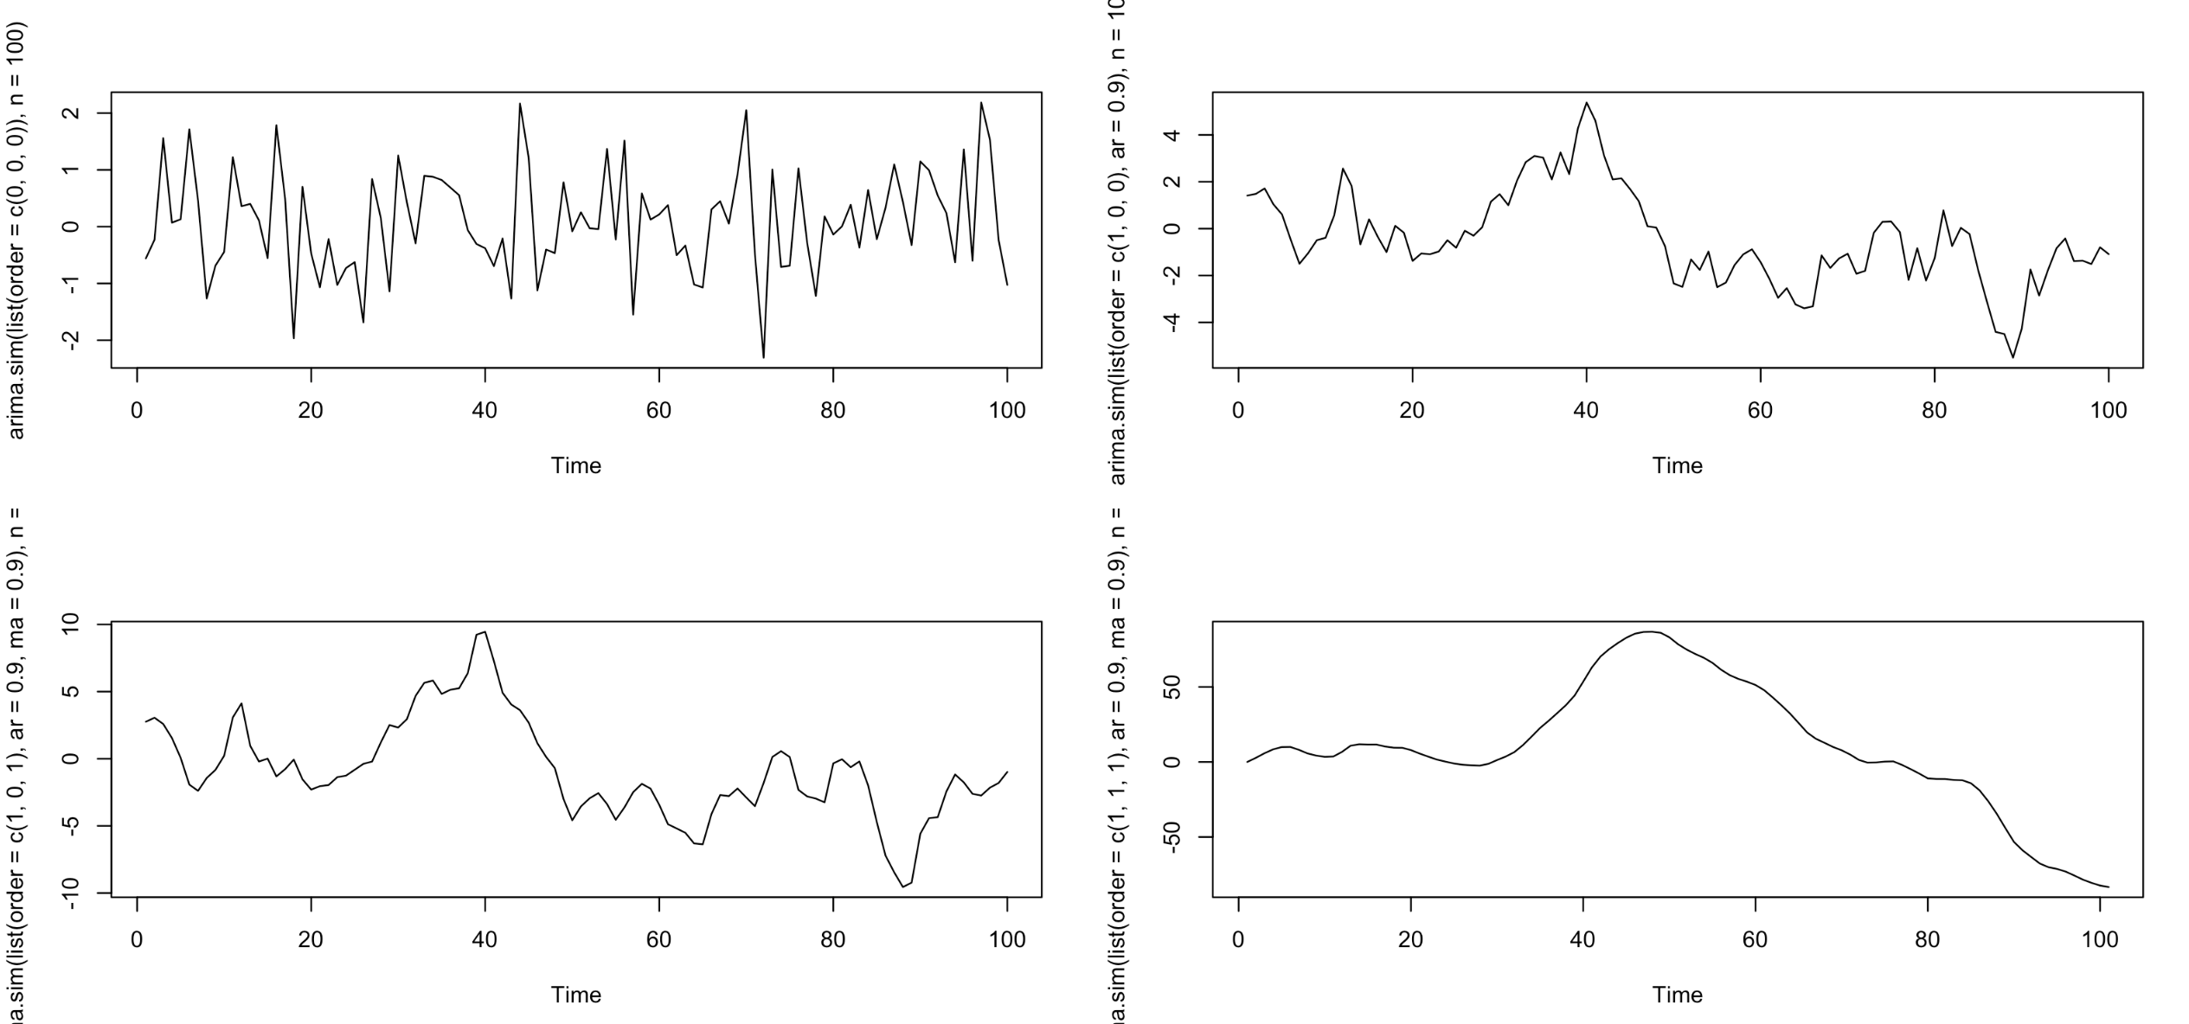
Simulating ARIMA (p,d,q) Model in R (see R code)

Slide 10
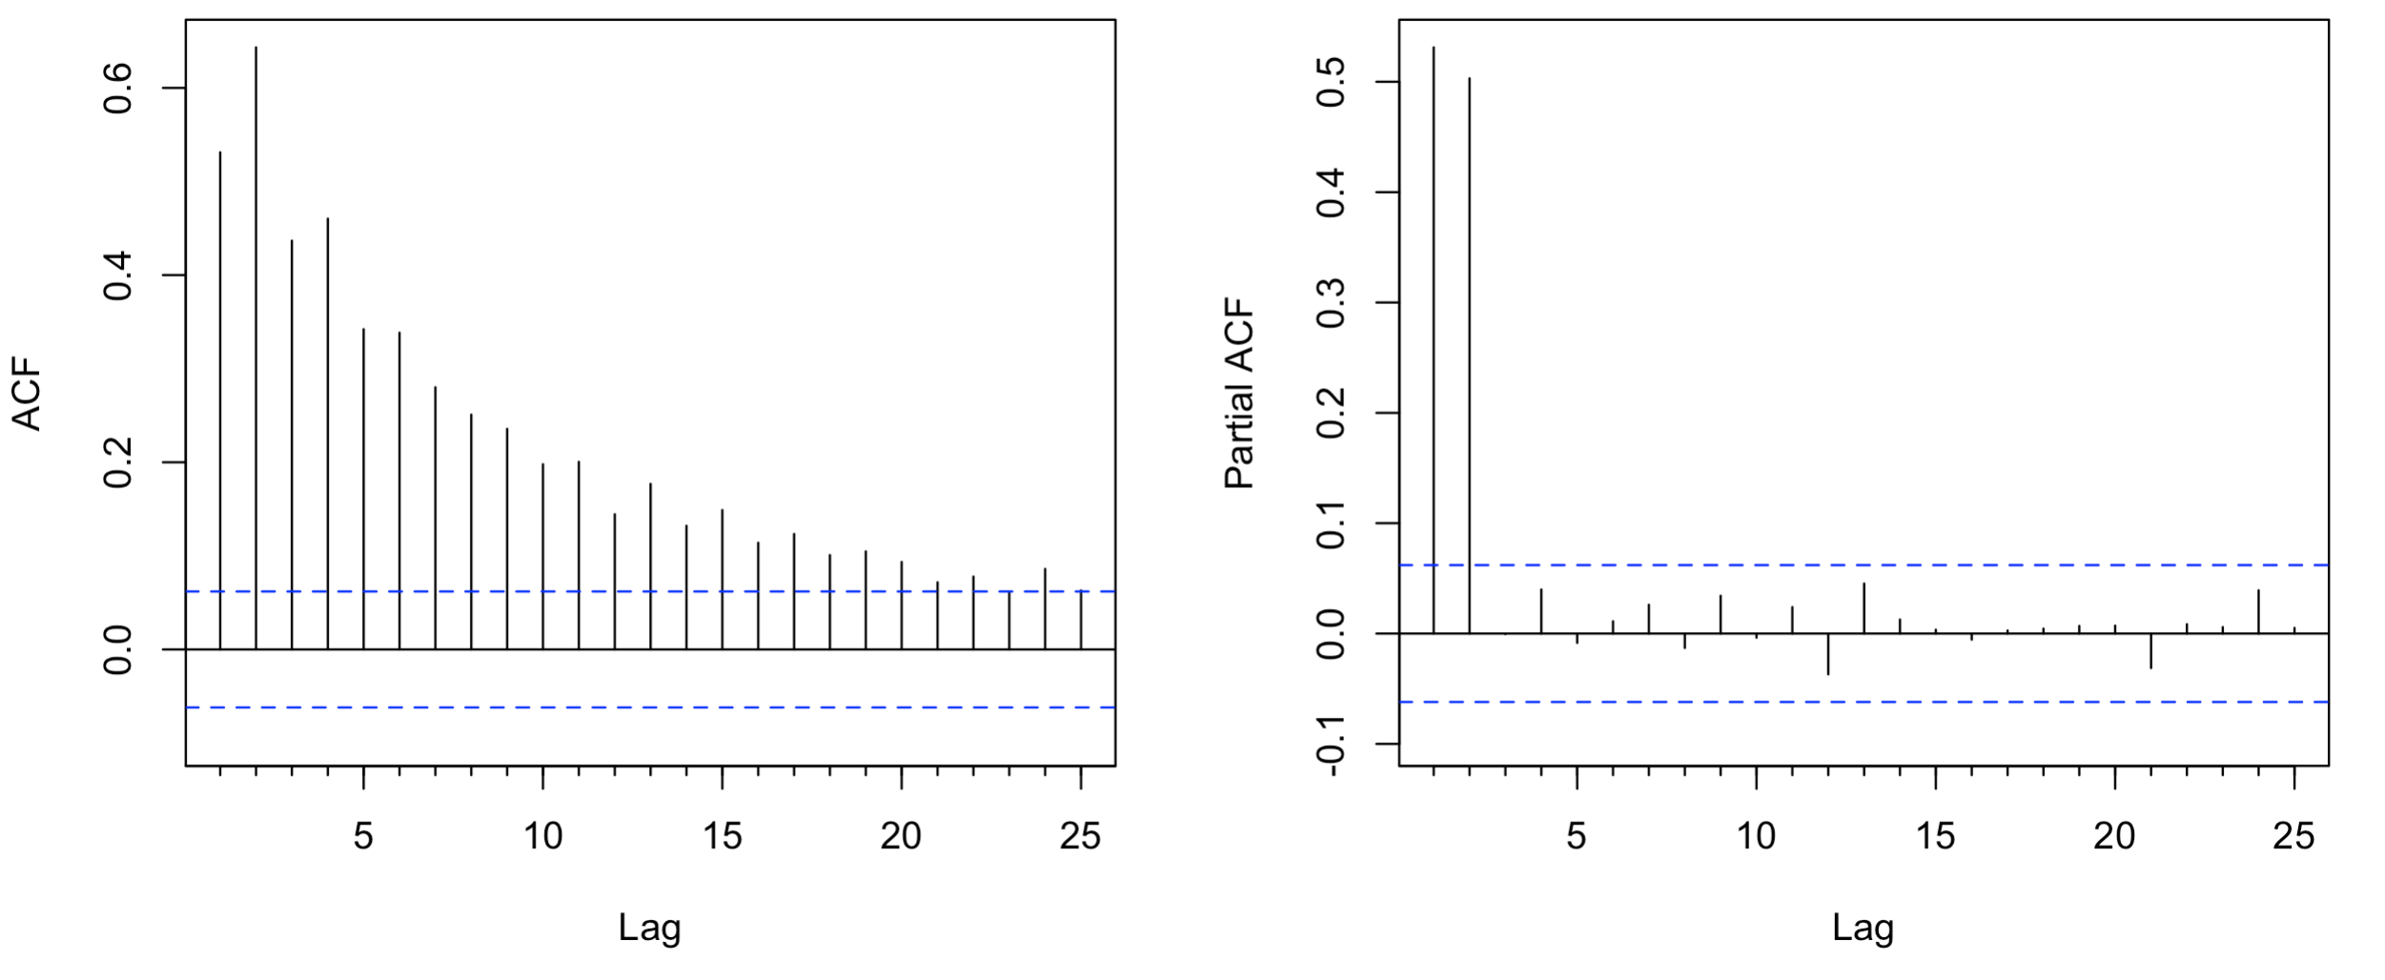
Autocorrelation and Partial Autocorrelation Functions
AR(2)
ACF: Tails off
PACF: Cuts off

Slide 11
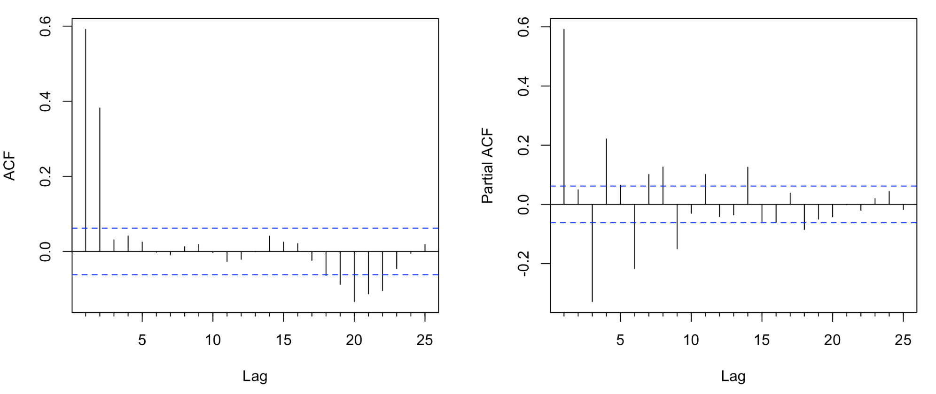
Autocorrelation and Partial Autocorrelation Functions
MA(2)
ACF: Cuts off
PACF: Tails off

Slide 12
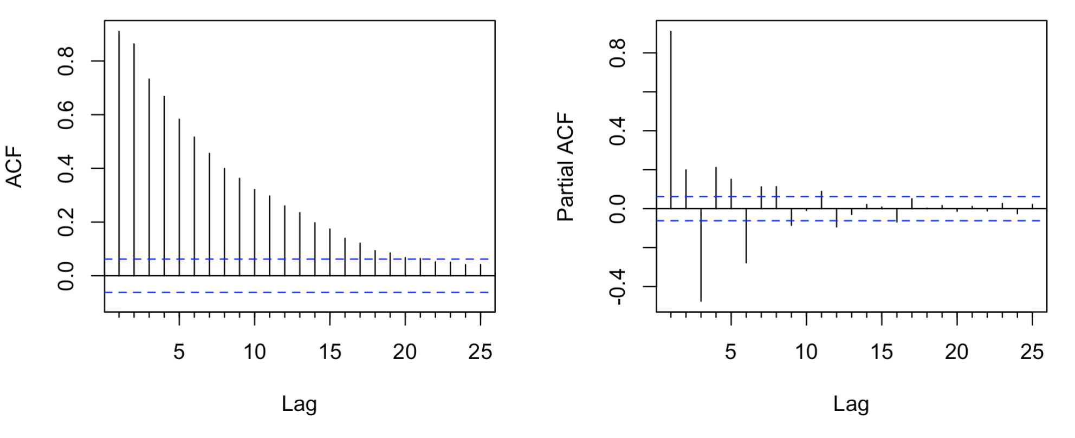
Autocorrelation and Partial Autocorrelation Functions
ARMA(2)
ACF: Tails off
PACF: Tails off

Slide 13
Box-Cox Transform
Box–Cox transformations are defined as

Slide 14
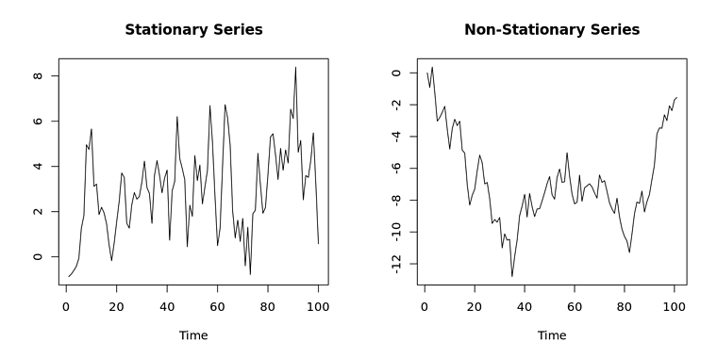
Stationarity
Fitting an ARMA model requires the time series to be stationary.
A series is said to be stationary when its mean, variance, and autocovariance are time invariant.
The augmented Dickey-Fuller (ADF) test is a formal statistical test for stationarity.

Slide 15
Order Selection: Akaike information criteria (AIC)
AIC is a criterion for model selection
We prefer the model with the minimum AIC value
One can improve the fit by adding parameters, but this may cause overfitting.
AIC introduces a penalty term for the number of parameters in the model.
AIC=2k-2ln(L), where k is the number of parameters, L is the log-likelihood.
When the sample size is small, AIC tends to overfit. AICc is a correction of AIC for small sample sizes:
where n denotes the sample size and k denotes the number of parameters

Slide 16
Order Selection: Bayesian information criteria (BIC)
Like AIC, BIC also has a penalty term for the number of parameters in the model. But the penalty term is larger in BIC than in AIC.
A lower BIC means that a model is considered to be better.
BIC penalizes model complexity more heavily than AIC.
Most of the times AIC/BIC will agree on the preferred model. When they don't, just report it.

Slide 17
Order Selection
These information criteria are not good at selecting the appropriate order of differencing (d)
They are only used for selecting the values of p and q.
This is because the differencing changes the data on which the likelihood is computed, making the AIC values between models with different orders of differencing not comparable.
So we need to use some other approach to choose d, and then we can use the criteria to select p and q.

Slide 18
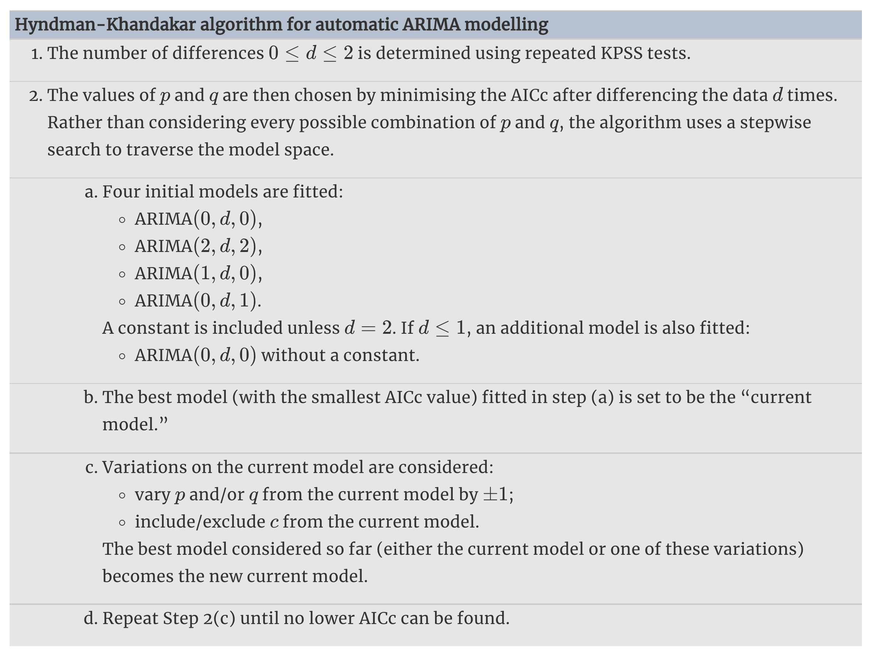
Fitting (non-seasonal) ARIMA model
Notes:
The default procedure uses some approximations to speed up the search. These approximations can be avoided with the argument approximation=FALSE.
It is possible that the minimum AICc model will not be found due to these approximations, or because of the use of a stepwise procedure. A much larger set of models will be searched if the argument stepwise=FALSE is used. See the help file for a full description of the arguments.

Slide 19

Data Source
https://ourworldindata.org

Slide 20


Slide 21
